Slide 1
MongoDB Limits, Sorting and Aggregation

Slide 2
Query embedded documents
copied
To specify an equality condition on a field that is an embedded/nested document, use the query filter document { <field>: <value> } where <value> is the document to match.
For example, the following query selects all documents where the field size equals the document { h: 14, w: 21, uom: "cm" }:
db.inventory.find( { size: { h: 14, w: 21, uom: "cm" } } )
Equality matches on the whole embedded document require an exact match of the specified <value> document, including the field order. For example, the following query does not match any documents in the inventory collection:
db.inventory.find( { size: { w: 21, h: 14, uom: "cm" } } )

Slide 3
Query an array
To query if the array field contains at least one element with the specified value, use the filter { <field>: <value> } where <value> is the element value.
The following example queries for all documents where tags is an array that contains the string "red" as one of its elements:
db.inventory.find( { tags: "red" } )
To specify conditions on the elements in the array field, use query operators in the query filter document:
{ <array field>: { <operator1>: <value1>, ... } }
For example, the following operation queries for all documents where the array dim_cm contains at least one element whose value is greater than 25.
db.inventory.find( { dim_cm: { $gt: 25 } } )

Slide 4
Query a null value or missing fields
Equality Filter
The { item : null } query matches documents that either contain the item field whose value is null or that do not contain the item field.
db.inventory.find( { item: null } )
Type Check
The { item : { $type: 10 } } query matches only documents that contain the item field whose value is null; i.e. the value of the item field is of BSON Type Null (type number 10) :
db.inventory.find( { item : { $type: 10 } } )
Existence Check
The following example queries for documents that do not contain a field. [1]
The { item : { $exists: false } } query matches documents that do not contain the item field:
db.inventory.find( { item : { $exists: false } } )

Slide 5
Aggregating Data
Aggregation operations process data records and return computed results.
Aggregation operations group values from multiple documents together, and can perform a variety of operations on the grouped data to return a single result. MongoDB provides three ways to perform aggregation:
the aggregation pipeline,
the map-reduce function, and
single purpose aggregation methods.

Slide 6
Aggregation Pipeline
Aggregation Pipeline
MongoDB’s aggregation framework is modeled on the concept of data processing pipelines. Documents enter a multi-stage pipeline that transforms the documents into an aggregated result. For example:
db.orders.aggregate([
{ $match: { status: "A" } },
{ $group: { _id: "$cust_id", total: { $sum: "$amount" } } }
])

Slide 7
Aggregation Pipeline
First Stage: The $match stage filters the documents by the status field and passes to the next stage those documents that have status equal to "A".
Second Stage: The $group stage groups the documents by the cust_id field to calculate the sum of the amount for each unique cust_id.
The most basic pipeline stages provide filters that operate like queries and document transformations that modify the form of the output document.
Other pipeline operations provide tools for grouping and sorting documents by specific field or fields as well as tools for aggregating the contents of arrays, including arrays of documents. In addition, pipeline stages can use operators for tasks such as calculating the average or concatenating a string.
The pipeline provides efficient data aggregation using native operations within MongoDB, and is the preferred method for data aggregation in MongoDB.

Slide 8
Map-Reduce
MongoDB also provides map-reduce operations to perform aggregation. In general, map-reduce operations have two phases: a map stage that processes each document and emits one or more objects for each input document, and reduce phase that combines the output of the map operation. Optionally, map-reduce can have a finalize stage to make final modifications to the result. Like other aggregation operations, map-reduce can specify a query condition to select the input documents as well as sort and limit the results.
Map-reduce uses custom JavaScript functions to perform the map and reduce operations, as well as the optional finalize operation. While the custom JavaScript provide great flexibility compared to the aggregation pipeline, in general, map-reduce is less efficient and more complex than the aggregation pipeline.

Slide 9
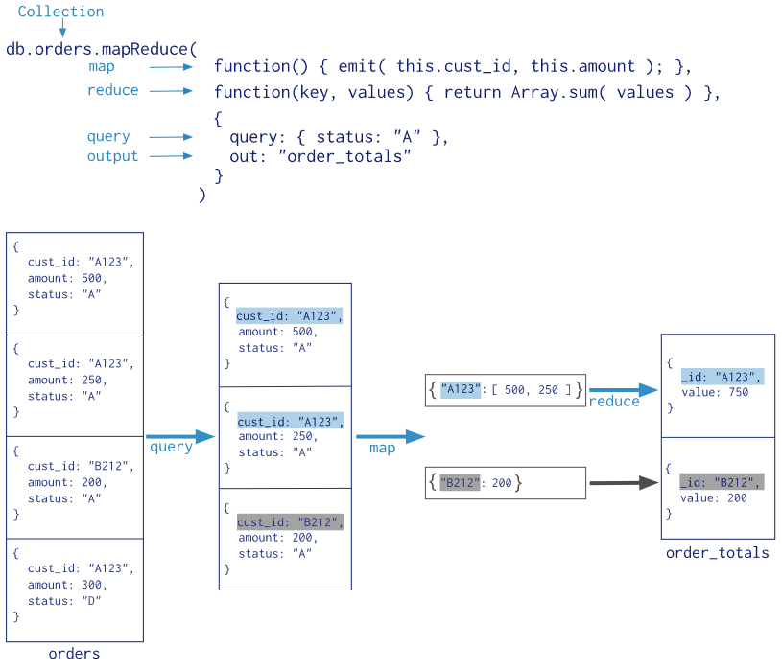
Map-Reduce

